Slide 1
Battle of Neighborhoods
IBM Applied Data Science Capstone

Slide 2
1.1 Introduction
In this dataset I will explore two cities of India - Mumbai and Banglore. Suppose a person gets a job in Mumbai and/or in Banglore and they need to find a new place to live along with all the places to explore like trending restaurants, food joints, parks, movie theater etc. Based on this assignment they can find a suitable place to live in the city with most favorable options. The datasets used for this case study is taken from Kaggle (Link provided below for both datasets). Both the dataset includes neighborhoods, type of properties, price of that properties, total area of the properties with their latitude and longitude. This will help us extract venues from the Foursquare API and divide them into different clusters. Here for the clusters, we will use K-means clustering.
- Mumbai data set - Kaggle
- Banglore data set- Kaggle

Slide 3
1.2 Introduction to Data
The Mumbai dataset contains 2 object data type `Neighbourhood` and `Type`. `Price`, `Area (sq.ft)`, `Latitude` and `Longitude` are numeric type. There are 34348 rows and 6 columns with 206088 total elements. There are missing and duplicate values that needs further analysis. The memory usage by this data set is 1.6+ MB.
There are 137 total neighborhoods and 3 types of properties in Mumbai.
The Banglore dataset has 2881 rows and 6 columns. Total elements in this dataset are 17286. There are same columns in this dataset as in Mumbai with price and Area(sq.ft) columns as category. There are missing and duplicate values in the data that needs further analysis. Total memory usage by the data set is 157.6+ KB.
There are 887 total neighbourhoods and 43 types of properties in Banglore.

Slide 4
EDA
Exploratory Data Analysis

Slide 5
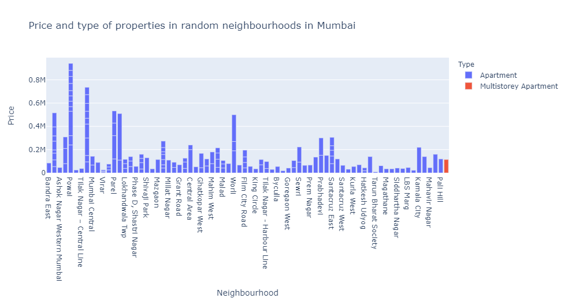
Types of Properties in Mumbai and their Rates

Slide 6
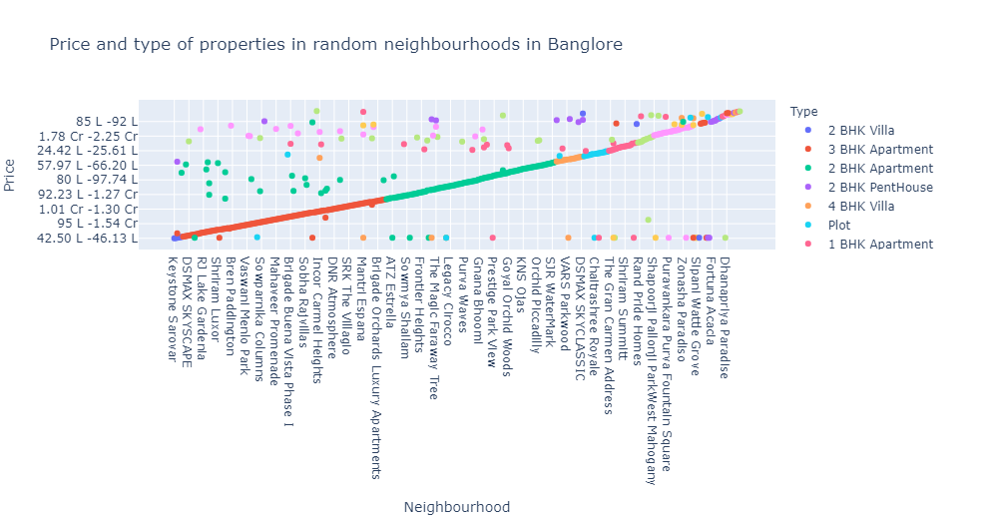
Types of Properties in Banglore and their Rates

Slide 7
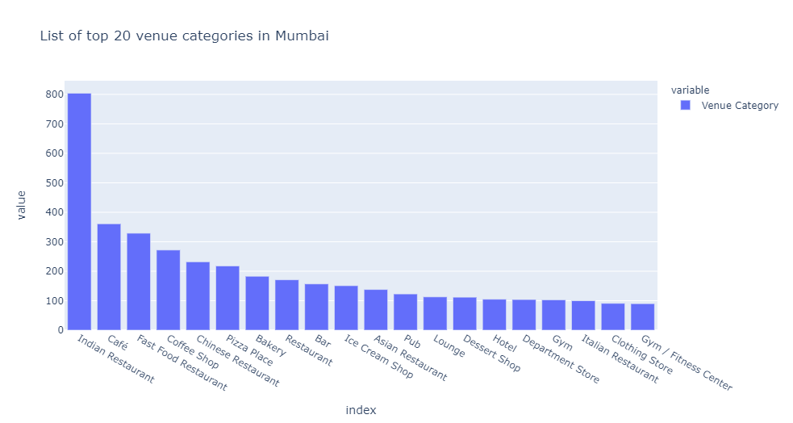
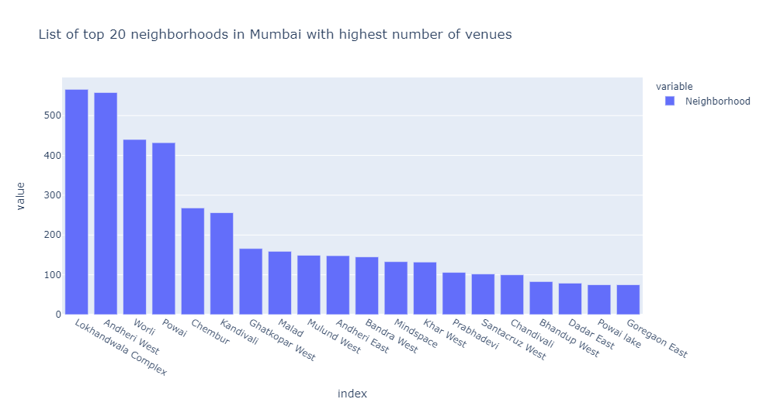
Which hood has most venues? - Mumbai

Slide 8
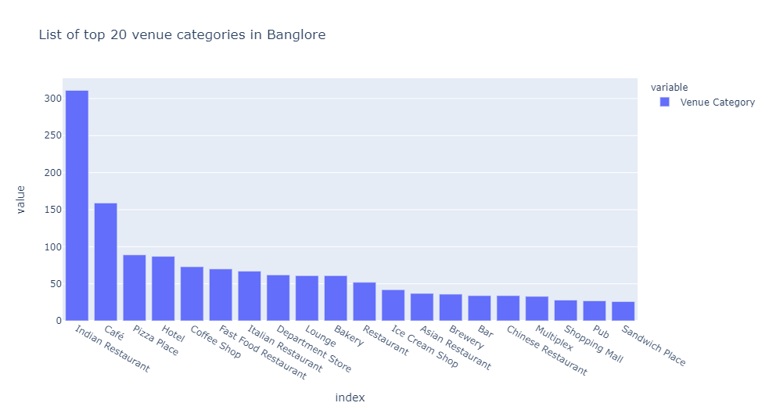
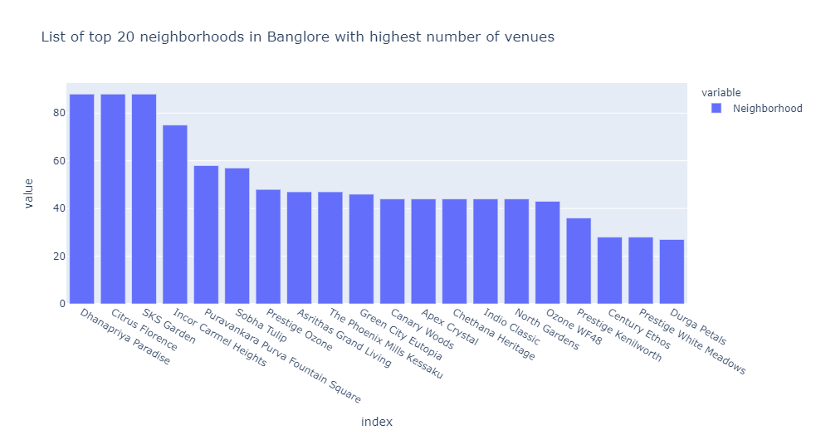
Which hood has most venues? - Banglore

Slide 9
Top 5 common venues in Mumbai and Banglore
Indian Restaurants
Fast Food Restaurants
Coffee Shop
Cafe
Pizza Place

Slide 10
Clustering
Using K-means Clustering

Slide 11
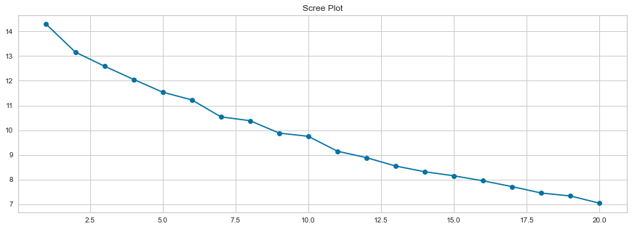
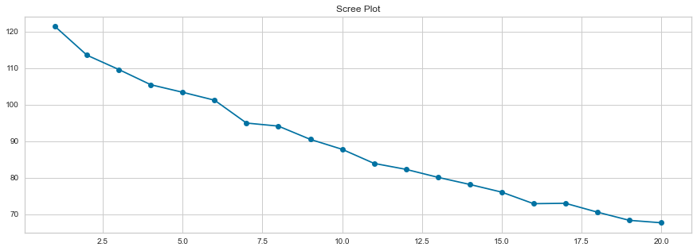
WSS Plot (Within Sum of Squares)
Mumbai
Banglore

Slide 12
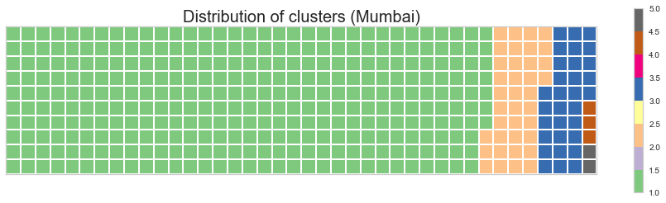
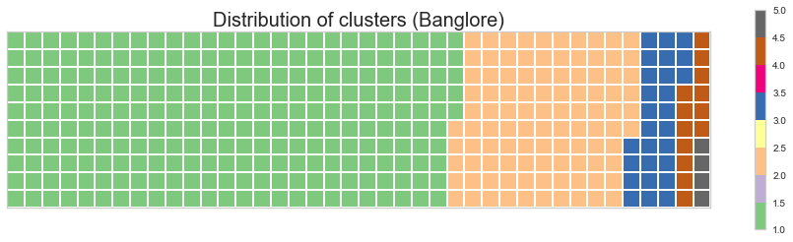
Clusters Distribution (k=5)

Slide 13
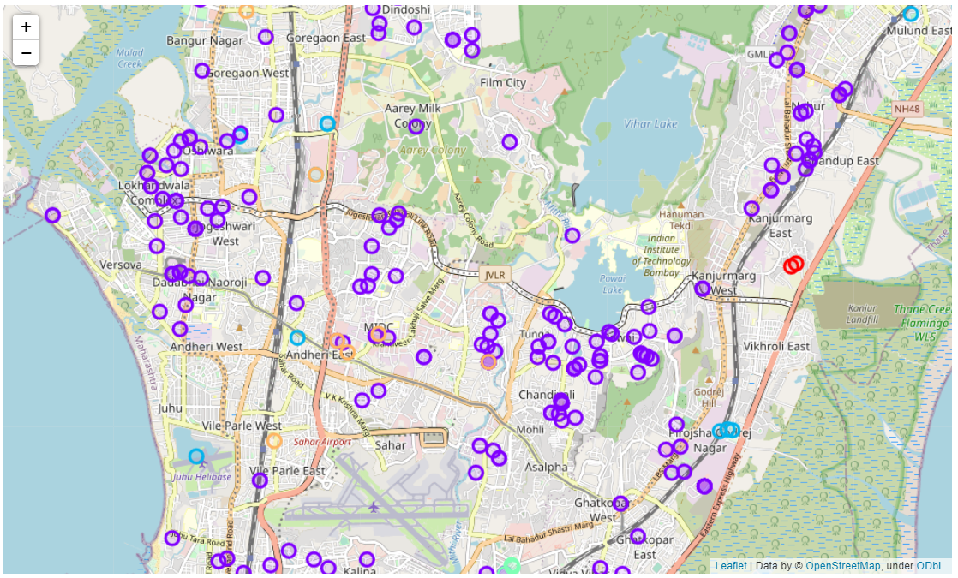
Mumbai

Slide 14
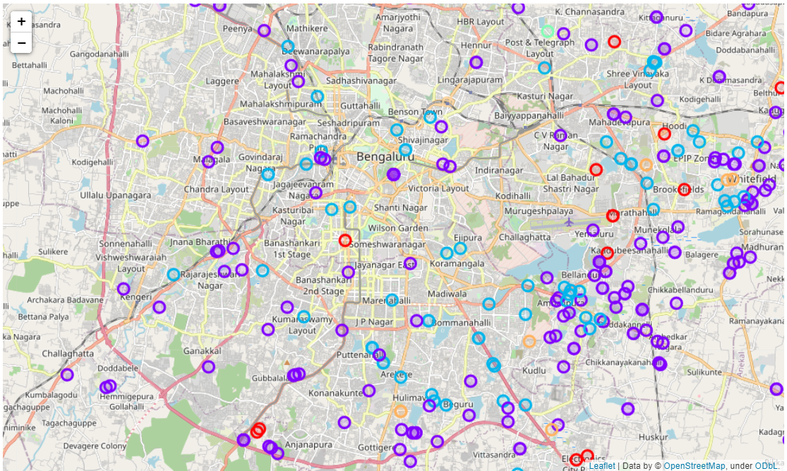
Banglore

Slide 15
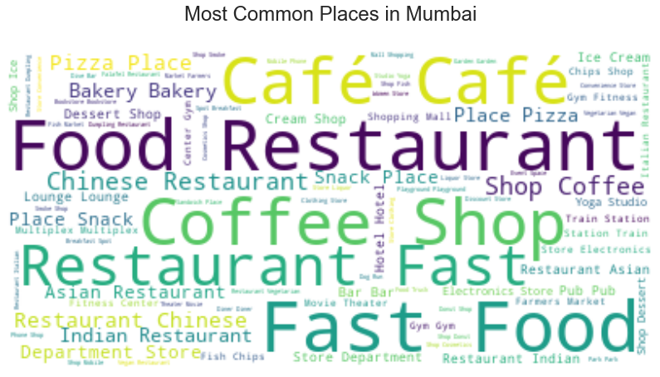
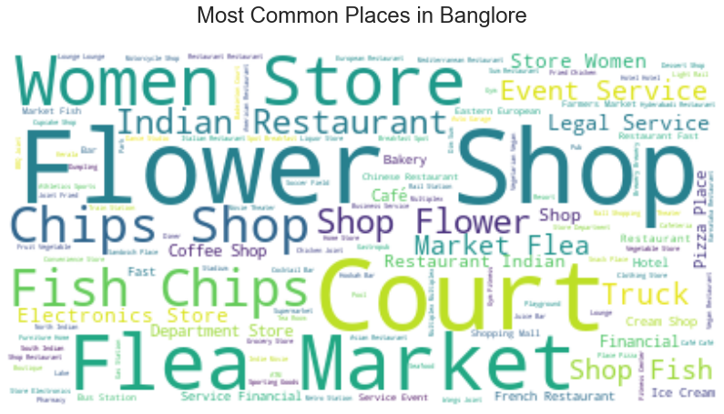
Most Common Places

Slide 16
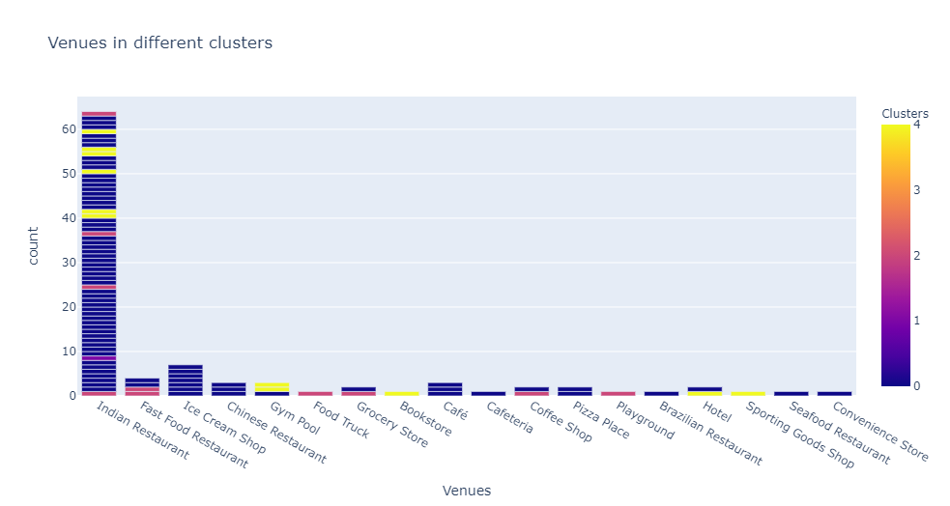
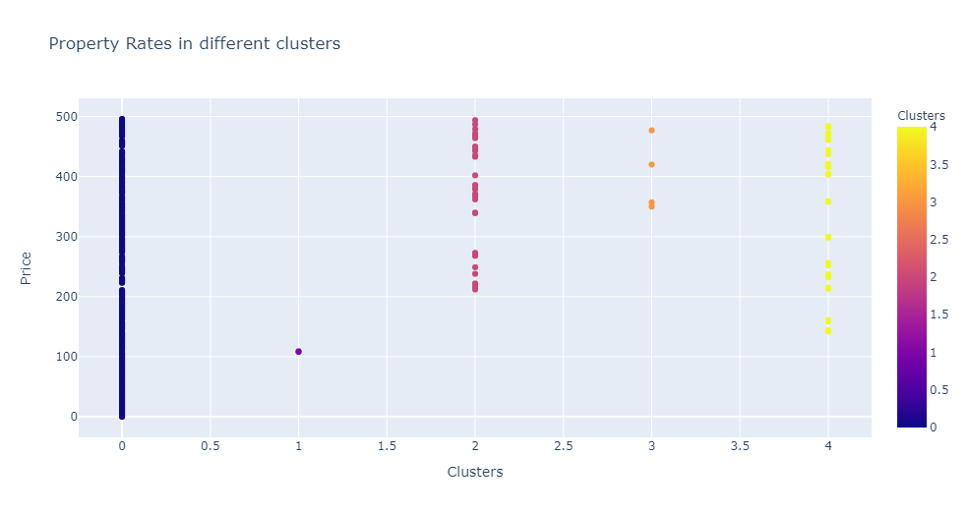
Mumbai Clusters
Common Venues
Property Rates

Slide 17
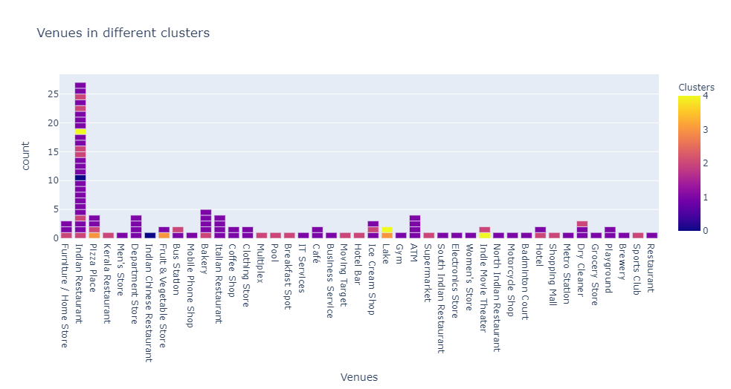
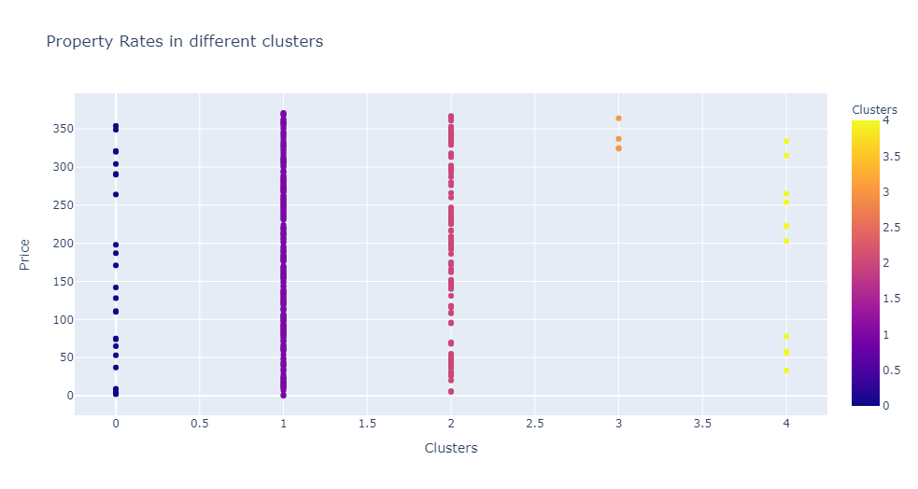
Banglore Clusters
Common Venues
Property Rates

Slide 18
Conclusion
Mumbai and Banglore

Slide 19
Conclusion - Mumbai
In Mumbai, we can see that the places with Indian Restaurants have diversified property rates.
Places with Shopping Malls, Hotels and Department Stores have high property rates.
Places with fast food restaurants, pizza place, café, theme park or historical sites have moderately high property rates.

Slide 20
Conclusion – Banglore
In Banglore, we can see that the places with Indian Restaurants and Karnataka Restaurant have high property rates.
Places with Supermarket, Hotel, Café have diversified property rates since these venues are common and likely to be in all neighborhoods.
Places with Women's Store, Food Truck or Food Court have high property rates.
Places with pool , motorcycle shop , clothing store or departmental store have moderately high property rates.

